Slide 1
Protein Quantitation II: Multiple Reaction Monitoring
Kelly Ruggles
kelly@fenyolab.org
New York University

Slide 2
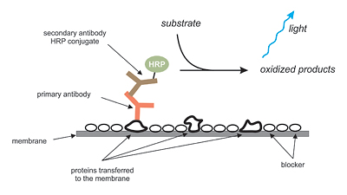
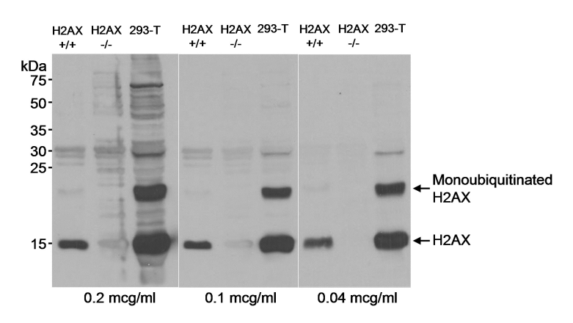
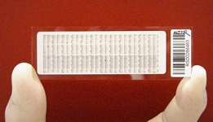
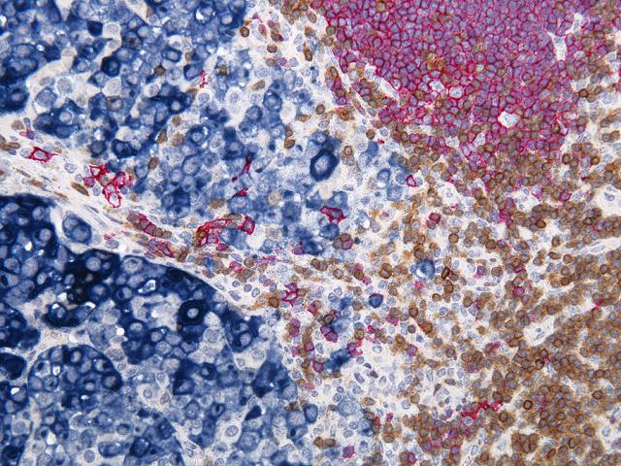
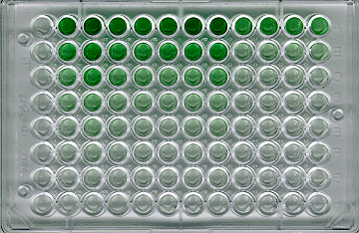
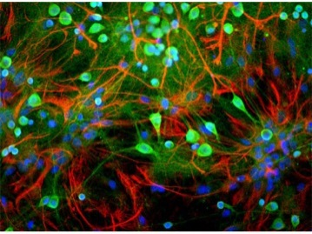
Traditional Affinity-based proteomics
Use antibodies to quantify proteins
Western Blot
RPPA
Immunohistochemistry
ELISA
Immunofluorescence

Slide 3
Mass Spectrometry based proteomic quantitation
Shotgun proteomics
LC-MS
Targeted MS
1. Records M/Z
1. Select precursor ion
MS
MS
Digestion
2. Selects peptides based on abundance and fragments
Fractionation
2. Precursor fragmentation
MS/MS
MS/MS
Lysis
3. Protein database search for peptide identification
3. Use Precursor-Fragment pairs for identification
Data Dependent Acquisition (DDA)
Uses predefined set of peptides

Slide 4
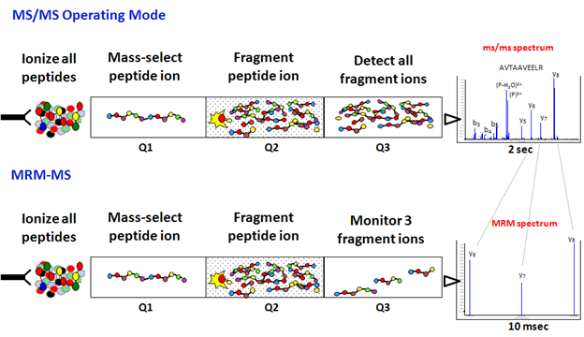
Multiple Reaction Monitoring (MRM)
Triple Quadrupole acts as ion filters
Precursor selected in first mass analyzer (Q1)
Fragmented by collision activated dissociation (Q2)
One or several of the fragments are specifically measured in the second mass analyzer (Q3)

Slide 5
Peptide Identification with MRM
Mass Select
Precursor
Mass Select
Fragment Ion
Fragment
Q1
Q2
Q3
Transition
Transition: Precursor-Fragment ion pair are used for protein identification
Select both Q1 and Q3 prior to run
Pick Q3 fragment ions based on discovery experiments, spectral libraries
Q1 doubly or triply charged peptides
Use the 3 most intense transitions for quantitation

Slide 6
Label-free quantification
Usually use 3 or more precursor-product ion pairs (transitions) for quantitation
Relies on direct evaluation of MS signal intensities of naturally occurring peptides in a sample.
Simple and straightforward
Low precision
Several peptides for each protein should be quantified to avoid false quantification

Slide 7
Stable Isotope Dilution (SID)
Use isotopically labeled reference protein
13C and/or 15N labeled peptide analogs
Chemically identical to the target peptide but with mass difference
Add known quantity of heavy standard
Compare signals for the light to the heavy reference to determine for precise quantification
Lysis
Fractionation
Digestion
Synthetic
Peptides
(Heavy)
Light
LC-MS
MS
L
H

Slide 8
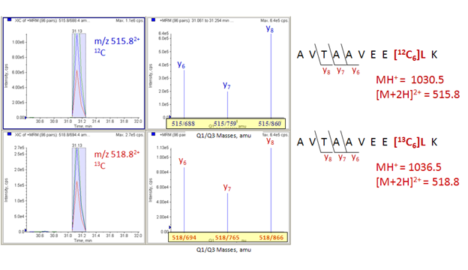
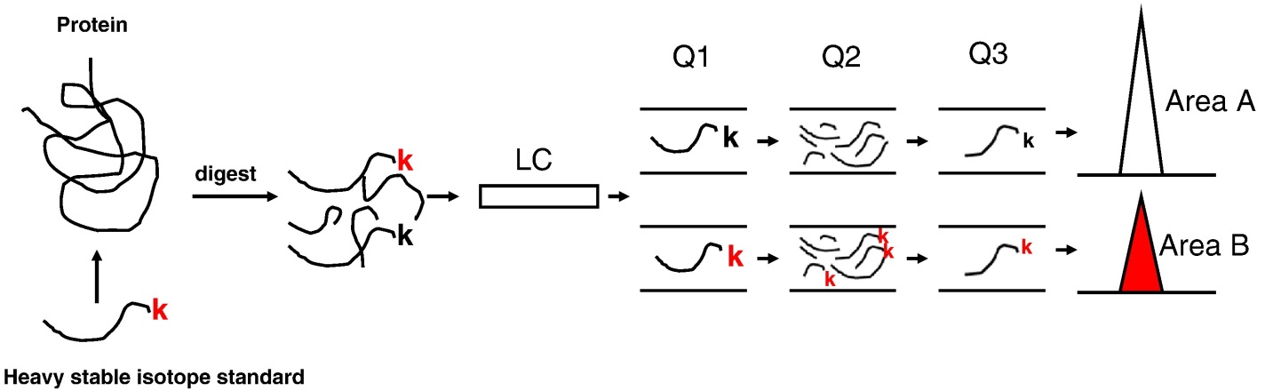
Fragment Ion Detection and Protein Quantitation
Q1
Q3
Light
Heavy
Meng Z and Veenstra TD, 2011

Slide 9
Quantification Details
MS
L
H
SIS: Stable Isotope Standard
PAR: Peak Area Ratio
Analyte
SIS
PAR = Light (Analyte) Peak Area
Heavy (SIS) Peak Area
Analyte concentration= PAR*SIS peptide concentration
-Use at least 3 transitions
-Have to make sure these transitions do not have interferences

Slide 10
Strengths of MRM
Can detect multiple transitions on the order of 10msec per transition
Can analyze many peptides (100s) per assay and the monitoring of many transitions per peptide
High sensitivity
High reproducibility
Detects low level analytes even in complex matrix
Golden standard for quantitation!

Slide 11
Weaknesses of MRM
Focuses on defined set of peptide candidates
Need to know charge state, retention time and relative product ion intensities before experimentation
Physical limit to the number of transitions that can be measured at once
Can get around this by using time-scheduled MRM, monitor transitions for a peptide in small window near retention time

Slide 12
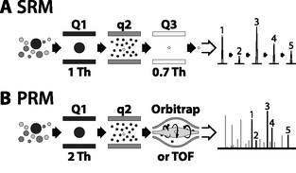
Parallel Reaction Monitoring (PRM)
Q3 is substituted with a high resolution mass analyzer to detect all target product ions
Generates high resolution, full scan MS/MS data
All transitions can be used to confirm peptide ID
Don’t have to choose ions beforehand
Peterson et al., 2012

Slide 13
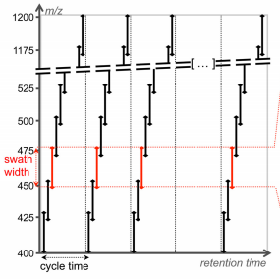
SWATH-MS: Data Collection
Data acquired on quadrupole-quadrupole TOF high resolution instrument cycling through 32-consecutive 25-Da precursor isolation windows (swaths).
Generates fragment ion spectra for all precursor ions within a user defined precursor retention time and m/z
Records the fragment ion spectra as complex fragment ion maps
32 discrete precursor isolation windows of
25–Da width across the 400-1200 m/z range
Gillet et al., 2012

Slide 14
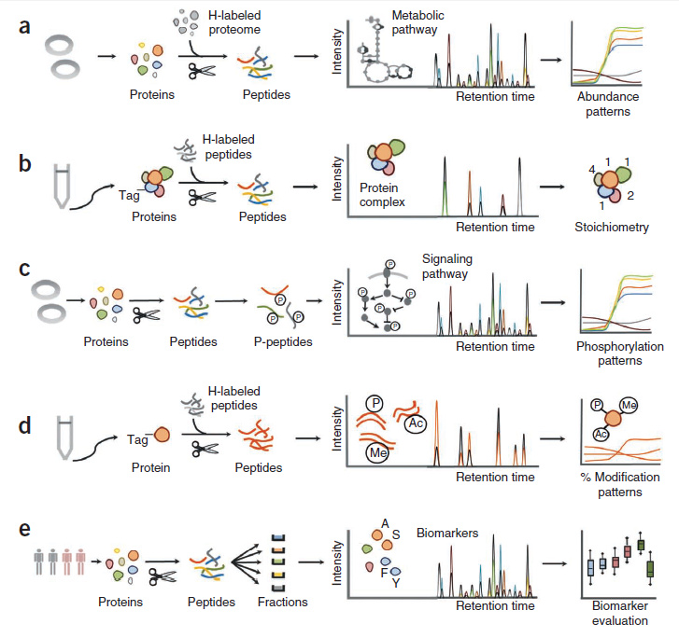
Applications of MRM
Metabolic pathway analysis
Protein complex
subunit stoichiometry
Phosphorylation
Modifications within protein
Biomarkers: protein indicator correlating to a disease state

Slide 15
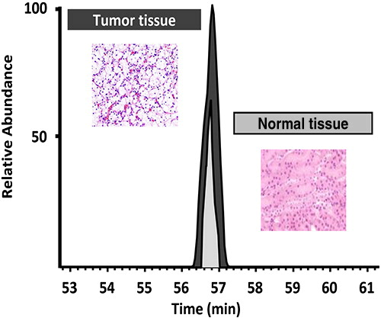
MRM and Biomarker Verification
Measurable indicator that provides the status of a biological state
Diagnosis
Prognosis
Treatment efficacy
Shotgun proteomics → Biomarker Discovery (<100 patients)
Targeted proteomics→ Biomarker Validation (~1000s patients)
Requires higher threshold of certainty
Remove high false positives from discovery phase
Most often plasma/serum, but can be tissue-based biomarkers
Meng Z and Veenstra TD, 2011

Slide 16
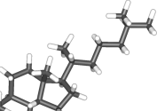
MRM and Biomarker Verification
Originally used to analyze small molecules since the late 1970s
More recently, used for proteins and peptide quantitation in complex biological matrices
With small molecules, the matrix and analyte have different chemical natures so separation step is able to remove other components from analytes
Separation
MS analysis
With proteomics, both the analytes and the background matrix are made up of peptides, so this separation cannot occur. Leads to decreased sensitivity and increased interference.
Separation
MS analysis

Slide 17
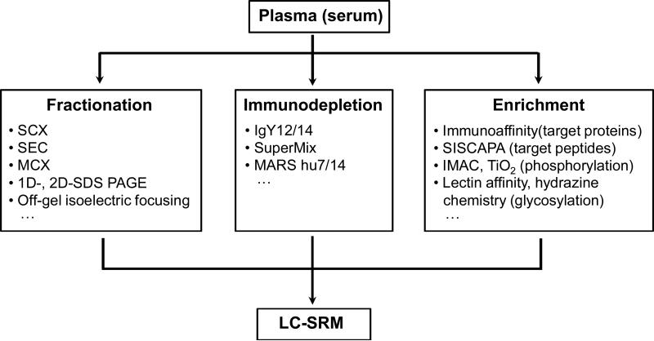
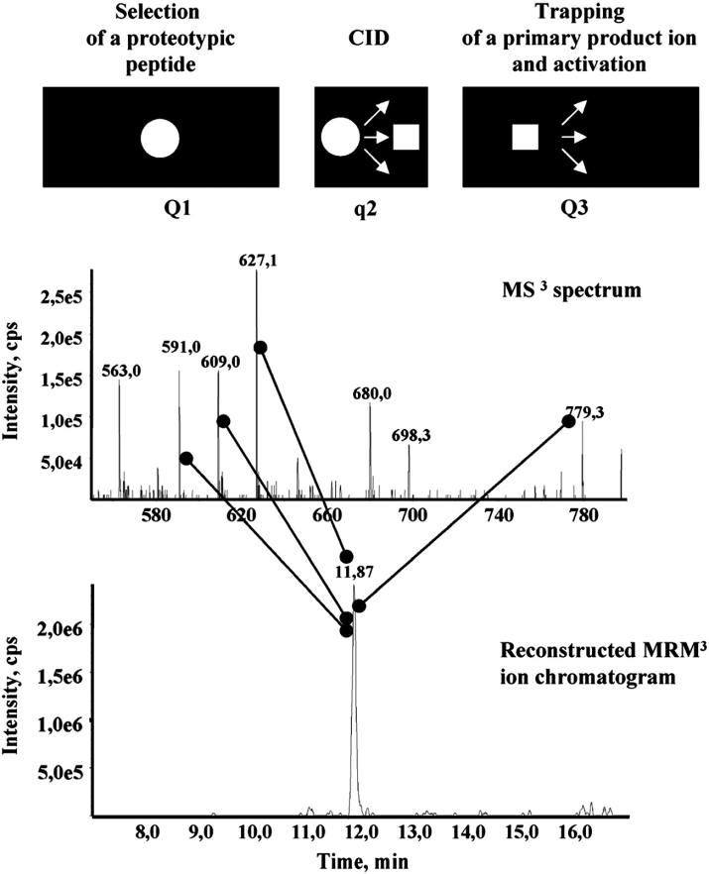
Enhancing MRM Sensitivity for Biomarker Discovery
MRM3
Further fragments product ions
Reduces background
Sample Enrichment
Shi T., et al. 2012
Meng Z and Veenstra TD, 2011

Slide 18
Workflow of MRM and PRM MS/MS
SRM
PRM
Target Selection
Selection of peptides
Selection of transitions
Validation of transitions
Peptide Calibration Curves
Target Selection
Selection of peptides
Selection of transitions
MS
Selection/ Validation of transitions
Peptide Calibration Curves
Slide from Dr. Reid Townsend, Washington University in St. Louis
Notes:
As Reid has discussed Parallel Reaction monitoring allows for the selection of transitions post-acquisition by collecting all transitions of each peptide and identifying “good” transitions using the data. We have developed new bioinformatics tools to aid in two steps of this analysis, the Selection of peptides and the validation of transitions post-MS acquisition.

Slide 19
Workflow of MRM and PRM MS/MS
SRM
PRM
Target Selection
Selection of peptides
Selection of transitions
Validation of transitions
Peptide Calibration Curves
Target Selection
Selection of peptides
Selection of transitions
MS
Selection/ Validation of transitions
Peptide Calibration Curves
Define a set of proteins based on clinical/biological question

Slide 20
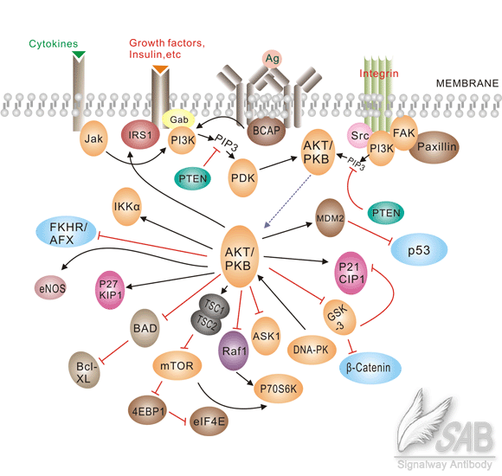
Motivating Example: AKT1 and Breast Cancer
AKT
PDK
BAD
MDM2
GSK3
mTOR
RAF1

Slide 21
Workflow of MRM and PRM MS/MS
SRM
PRM
Target Selection
Selection of peptides
Selection of transitions
Validation of transitions
Peptide Calibration Curves
Target Selection
Selection of peptides
Selection of transitions
MS
Selection/ Validation of transitions
Peptide Calibration Curves
Proteotypic
Consistently observed by LC-MS methods

Slide 22
Selecting Peptides
A few representative peptides will be used to quantify each protein
Need to fulfill certain characteristics
Have an unique sequence
Consistently observed by LC-MS methods
8-25 amino acids
Good ionization efficiency
m/z within the range of the instrument
No missed cleavages
Not too hydrophillic (poorly retained) or hydrophobic (may stick to column)

Slide 23
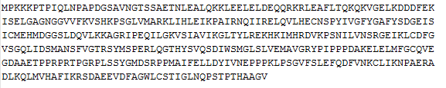
Identifying Proteotypic Peptides
Step 1: Full protein sequence in FASTA format
Set of Proteins
Trypsin
Peptides
Step 2: Tryptic Peptides
PTPIQLNPAPDGSAVNGTSSAETNLEALQK
LEAFLTQK
PSNIVLVNSR
LEELELDEQQR
DDDFEK…..
RefSeq
Ensembl
Uniprot
Proteotypic Peptides
Step 3: Compare to human reference database
-Contain all peptide sequences
-Find all peptides that only map back to one gene
PTPIQLNPAPDGSAVNGTSSAETNLEALQK
LEAFLTQK
PSNIVLVNSR
LEELELDEQQR
DDDFEK…..
Match peptide to proteins
Match proteins to genes
(Reference Protein DB)
(Using protein names and genomic DB)

Slide 24
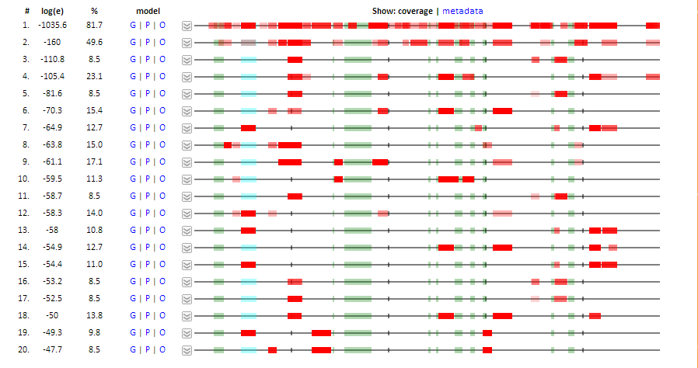
LC/MS Properties: GPMDB
-Compares peptides to a collection of previously observed results
-Determines how many times the peptide has been observed by others
-Most proteins show very reproducible peptide patterns

Slide 25
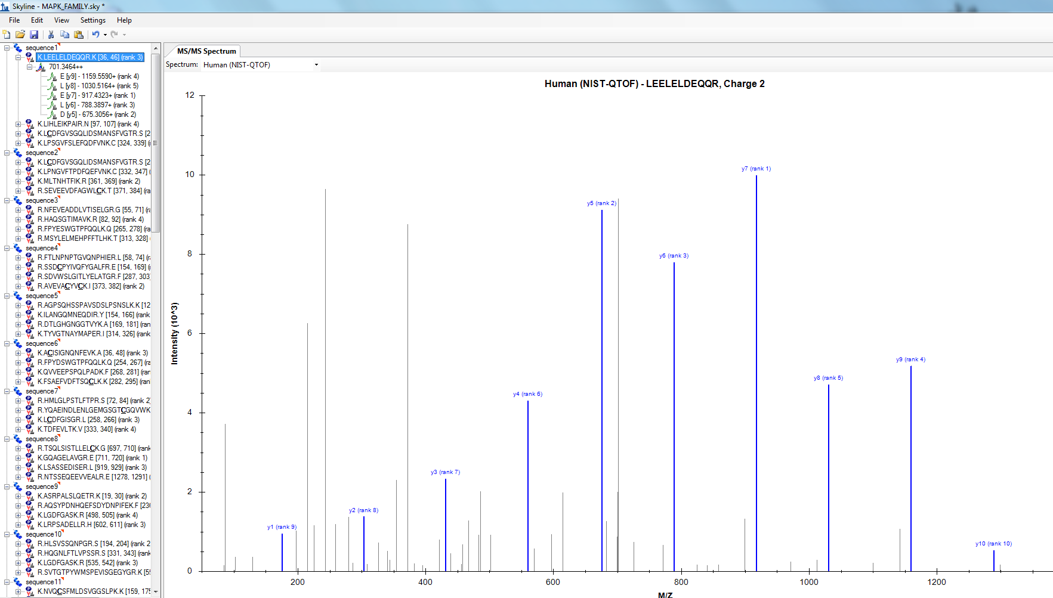
LC/MS Properties: Skyline
-Compares peptides to MS/MS spectral library
-Predicts most abundant transitions

Slide 26
Workflow of MRM and PRM MS/MS
SRM
PRM
Target Selection
Selection of peptides
Selection of transitions
Validation of transitions
Peptide Calibration Curves
Target Selection
Selection of peptides
Selection of transitions
MS
Selection/ Validation of transitions
Peptide Calibration Curves
PRM allows for selection of transitions post-data acquisition

Slide 27
Selecting Transitions
Limitation of MRM-MS: ~1-2 m/z unit window for precursor and fragment ion occasionally let in interfering peptides with similar characteristics
If we want to use these transitions for quantitation, we need to be confident there are no interferences
Largest always largest, smallest always smallest etc.
b-fragments of high m/z are less represented on QqQ
MRM

Slide 28
Selecting Transitions
Limitation of MRM-MS: ~1-2 m/z unit window for precursor and fragment ion occasionally let in interfering peptides with similar characteristics
If we want to use these transitions for quantitation, we need to be confident there are no interferences
Largest always largest, smallest always smallest etc.
b-fragments of high m/z are less represented on QqQ
MRM
Peptide of interest
Interfering peptide

Slide 29
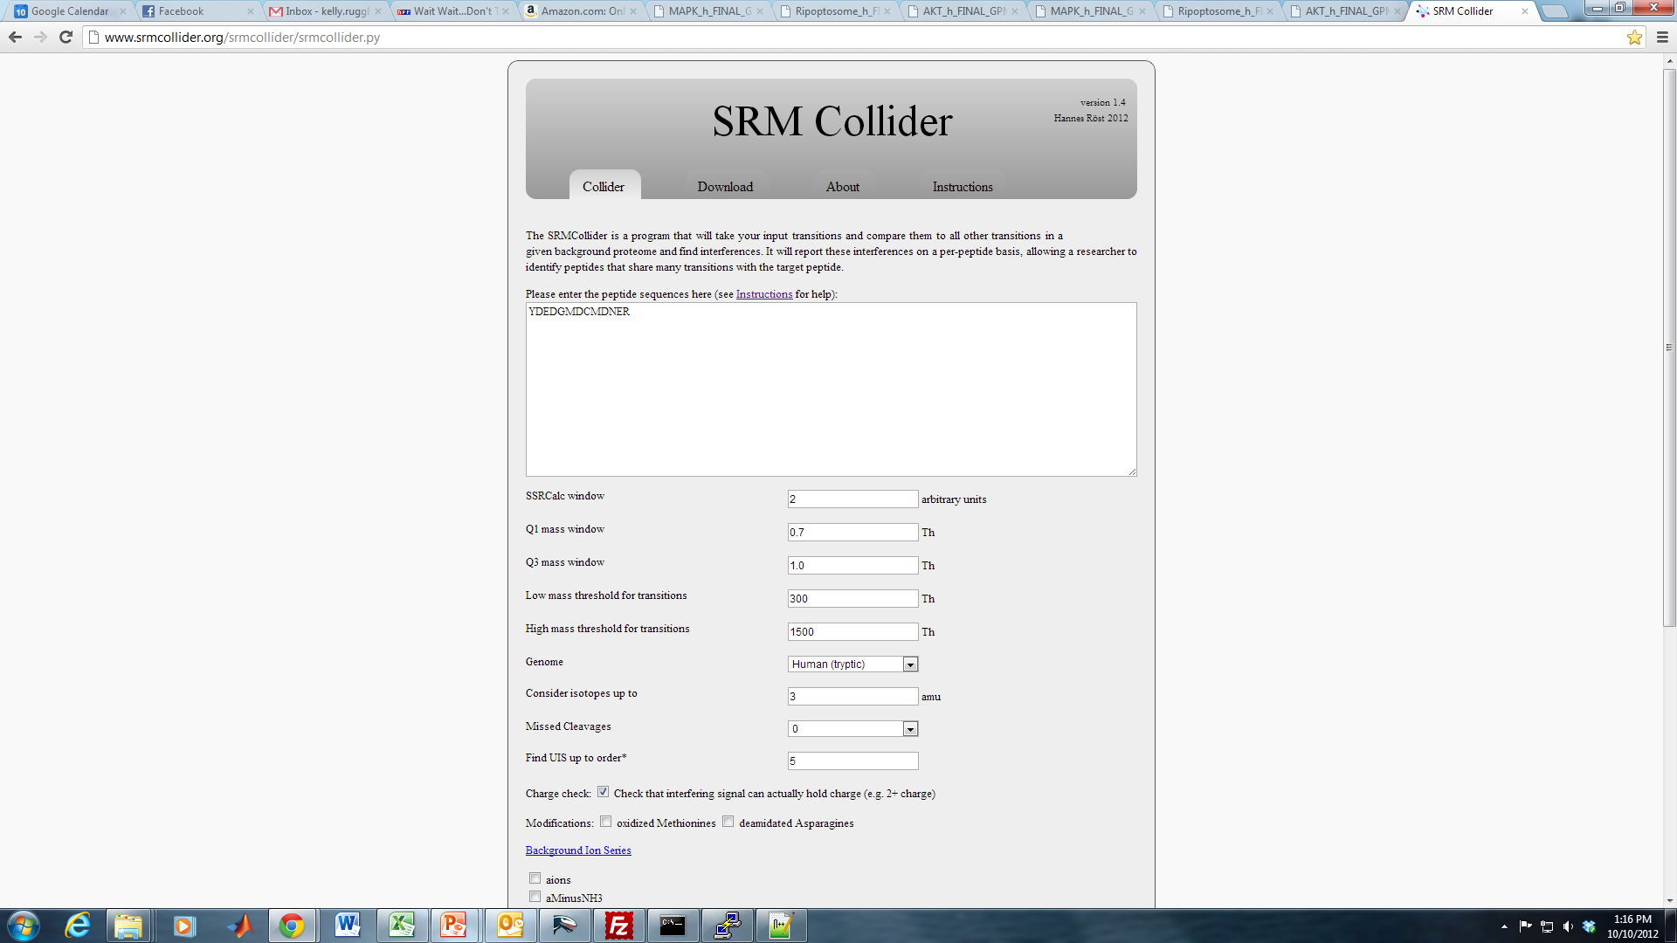
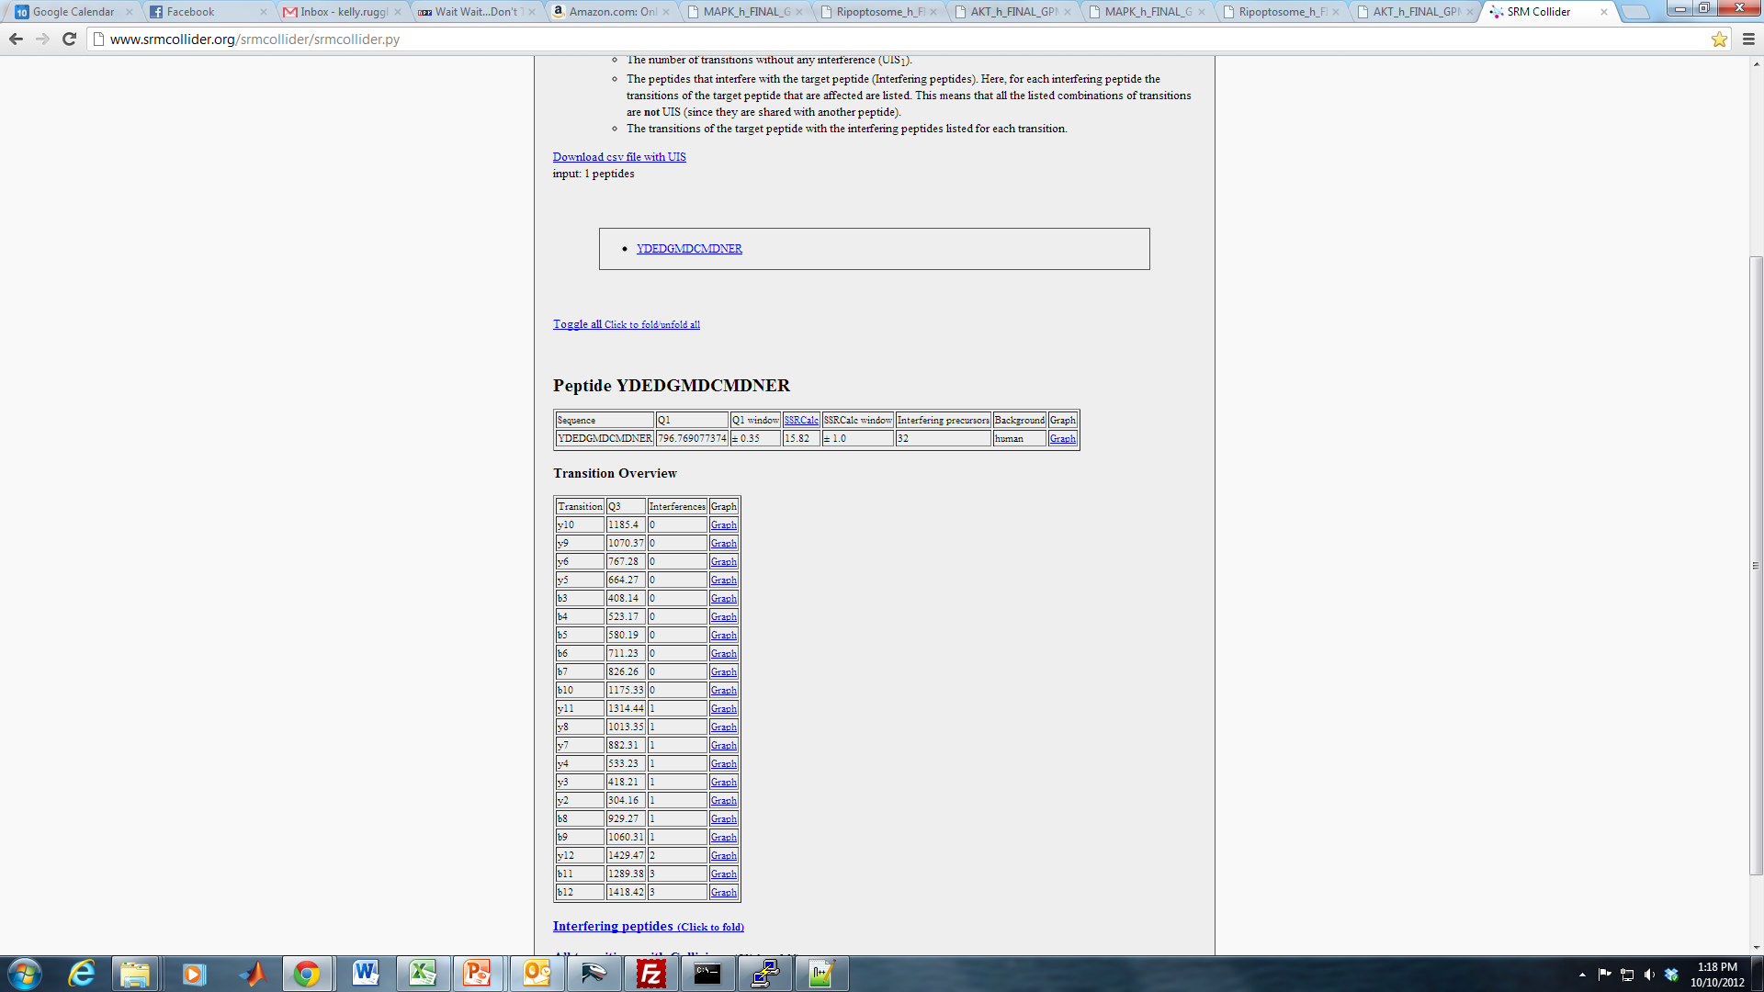
Selecting Transitions: SRMCollider
Input peptides of interest
Determines the m/z values for transition pair
Simulates a typical SRM experiment
Predicts fragment intensities and retention time information for input peptide
Compares the transition to all other transitions in a background proteome
Outputs the number of predicted interferences for each transition for that peptide
Input peptide sequence
Choose peptides that have at least one transition with zero interferences

Slide 30
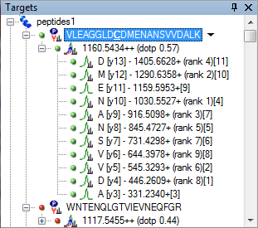
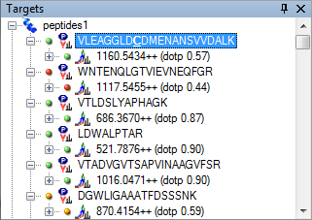
Selecting Transitions: Skyline
Can use to find best transitions to pick
Intensity (rank)
Dot product (similarity to reference spectra)
Want high rank and dotp close to 1

Slide 31
Workflow of MRM and PRM MS/MS
SRM
PRM
Target Selection
Selection of peptides
Selection of transitions
Validation of transitions
Peptide Calibration Curves
Target Selection
Selection of peptides
Selection of transitions
MS
Selection/ Validation of transitions
Peptide Calibration Curves

Slide 32
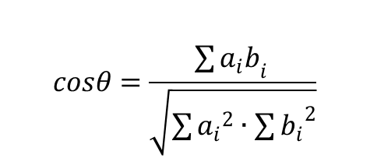
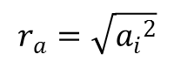
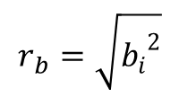
Validating Transitions: Contrast Angle
Spectral Contrast Angle: each spectrum represented as a vector in N-dimensional space
Spectra that resemble each other have vectors pointing in the same direction (θ ~ 0°)
$$cosθ=\frac{\sum{{a_{i}b}_{i }}}{\sqrt{\sum{{a_{i}}^{2}}∙\sum{{b_{i}}^{2}}}}$$
Analyte
SIS
a₁
b₂
b₁
$$r_{a}=\sqrt{{a_{i}}^{2}}$$
a₂
r_{a}
$$r_{b}=\sqrt{{b_{i}}^{2}}$$
r_{b}

Slide 33
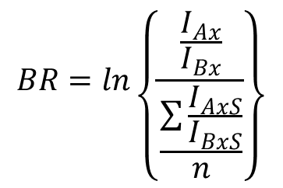
Validating Transitions: “Branching ratio”
Branching Ratio (BR): ratio of the peak intensities
$$BR=ln\left\{\frac{\frac{I_{Ax}}{I_{Bx}}}{\frac{\sum{\frac{I_{AxS}}{I_{BxS}}}}{n}}\right\}$$
Light (Analyte)
Heavy(SIS)
I₁
I₃
I₁
I₂
I₂
I₃
I_{Ax}, I_{Bx} : Peak areas of Analyte
I_{AxS}, I_{BxS} : Peak areas of SIS
n=number of SIS transitions
Kushnir, 2005

Slide 34
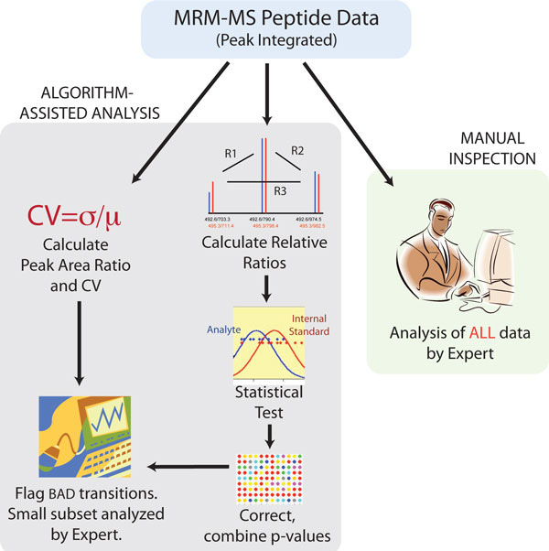
Validating Transitions in MRM: AuDIT
AuDIT: Automated Detection of Inaccurate and imprecise Transitions
Uses “branching ratio”
1. Calculate relative ratios of each transition from the same precursor
2. Apply t-test to determine if relative ratios of analyte are different from relative ratios of SIS
http://www.broadinstitute.org/cancer/software/genepattern/modules/AuDIT.html.

Slide 35
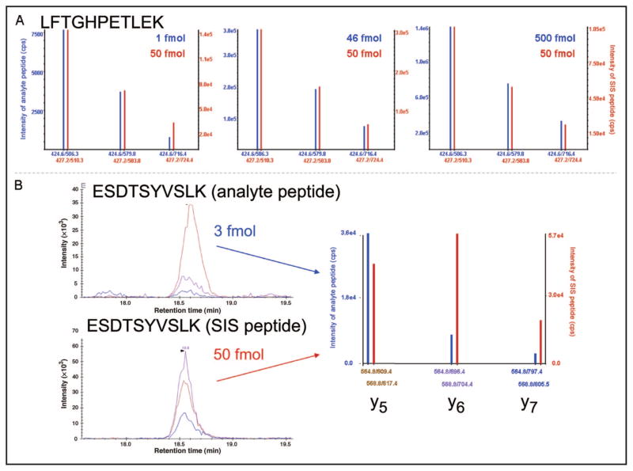
Validating Transitions in MRM: AuDIT
Blue: Light
Red: Heavy
Relative product ions should have a constant relationship
Abbatiello, 2009

Slide 36
Validating Transitions in PRM: CRAFTS
PRM and MRM are most useful when quantifying protein in a complex matrix
Tumor lysate
Plasma
Simple Matrix (buffer) should have no interferences
Compare the transitions in complex to those in simple
Ratio close to 1 indicates low interference

Slide 37
Validating Transitions in PRM: CRAFTS
PEPTIDE
Light
Heavy
Simple
MATRIX
Complex
Simple matrix: peptide carrier solution
Complex matrix: unfractionated tumor digest
Simple matrix should have minimal interference- use this as reference
Transitions in complex buffer should have the same relative intensities of transitions within the spectra
Transitions in complex with relative intensities different from simple → interference

Slide 38
Validating Transitions in PRM: CRAFTS
Light
Ratio of Transitions
 | y2 | y5 | y10
y2 | 1 | y5/y2 | y10/y2
y5 | y2/y5 | 1 | y10/y5
y10 | y2/y10 | y5/y10 | 1
100
Simple
60
40
 | y2 | y5 | y10
y2 | 1 | 0.4 | 0.6
y5 | 2.5 | 1 | 1.5
y10 | 1.67 | 0.67 | 1
220
150
Simple
Matrix
Complex
90
Transition | Simple | Complex
y2 | 100 | 150
y5 | 40 | 220
y10 | 60 | 90
 | y2 | y5 | y10
y2 | 1 | 1.47 | 0.6
y5 | 0.68 | 1 | 0.41
y10 | 1.67 | 2.44 | 1
Complex
Matrix

Slide 39
Validating Transitions in PRM: CRAFTS
Ratio of Transitions
 | y2 | y5 | y10
y2 | 1 | y5/y2 | y10/y2
y5 | y2/y5 | 1 | y10/y5
y10 | y2/y10 | y5/y10 | 1
 | y2 | y5 | y10
y2 | 1 | 0.4 | 0.6
y5 | 2.5 | 1 | 1.5
y10 | 1.67 | 0.67 | 1
Complex/Simple
Simple
Matrix
 | y2 | y5 | y10
y2 | 1 | 3.675 | 1
y5 | 0.272 | 1 | 0.273
y10 | 1 | 3.641 | 1
 | y2 | y5 | y10
y2 | 1 | 1.47 | 0.6
y5 | 0.68 | 1 | 0.41
y10 | 1.67 | 2.44 | 1
Complex
Matrix

Slide 40
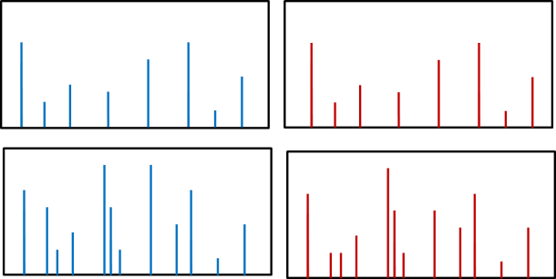
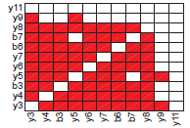

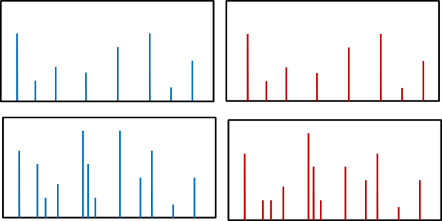
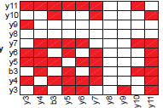
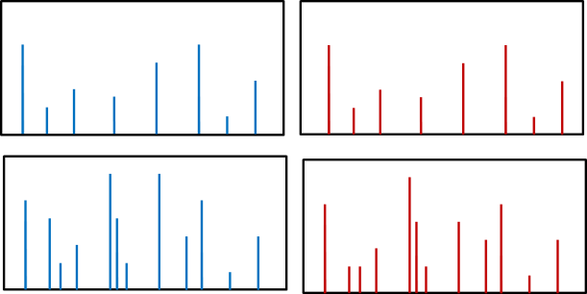
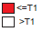
Validating Transitions in PRM: CRAFTS
Ratio of transitions (Branching Ratio)
Complex/Simple
(Combinatorial Ratio)
Visualize Complex/Simple
Choose “good” transitions
Simple
Light
Complex
Minimal Interference: y3, y4, b3, y5, y6, y7, b6, b7, y8
Simple
Heavy
Complex
<= Threshold
> Threshold
Minimal Interference: y3, y4, b3, y5, y6, y7, y10, y11

Slide 41
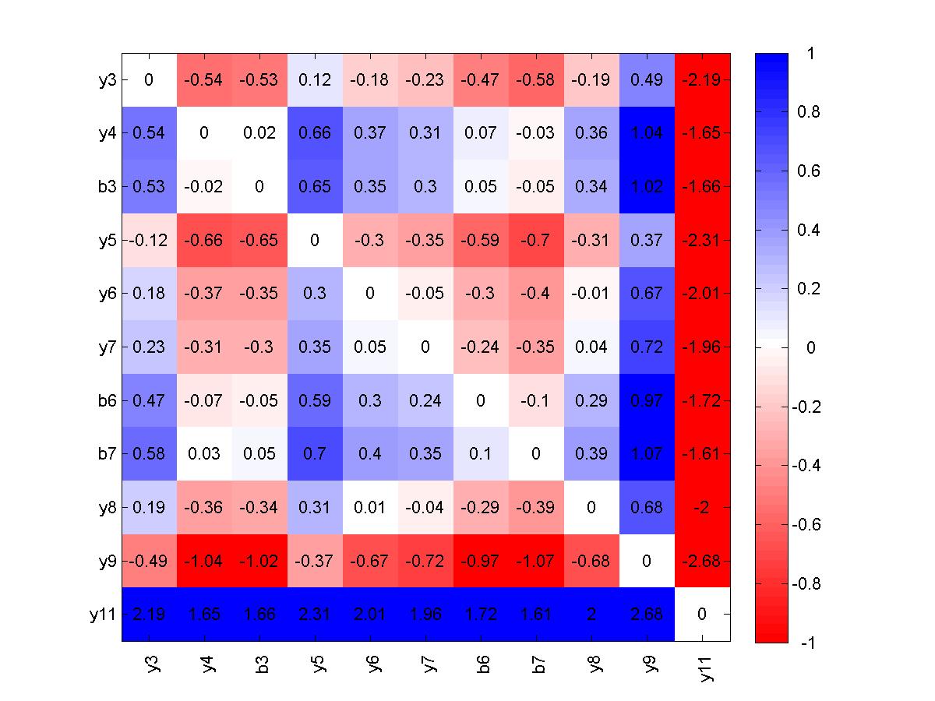
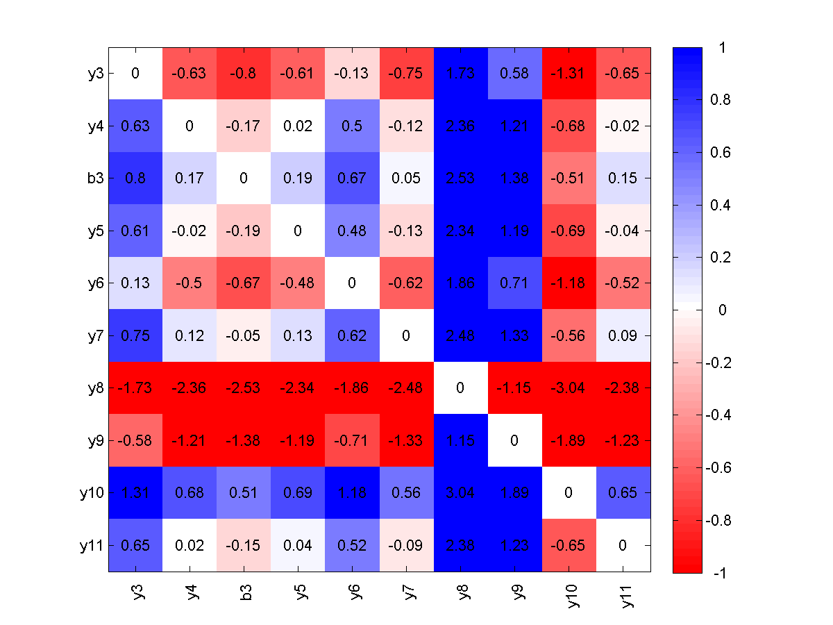
Validating Transitions in PRM: CRAFTS
Light
Heavy
Minimal Interference: y3, y4, b3, y5, y6, y7, b6, b7, y8
With Interference: y9, y11
Minimal Interference: y3, y4, b3, y5, y6, y7, y10, y11
With Interference: y8, y9
Use highlighted values to get mean ratio

Slide 42
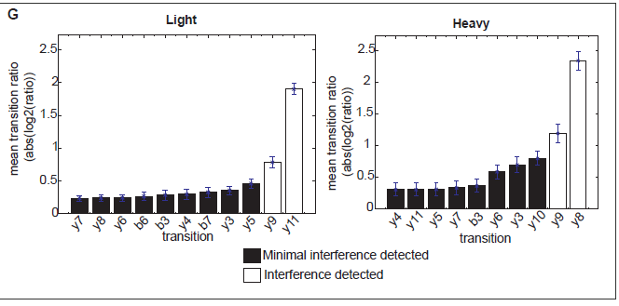
CRAFTS: Ranking Transitions by Mean Combinatorial Ratio

Slide 43
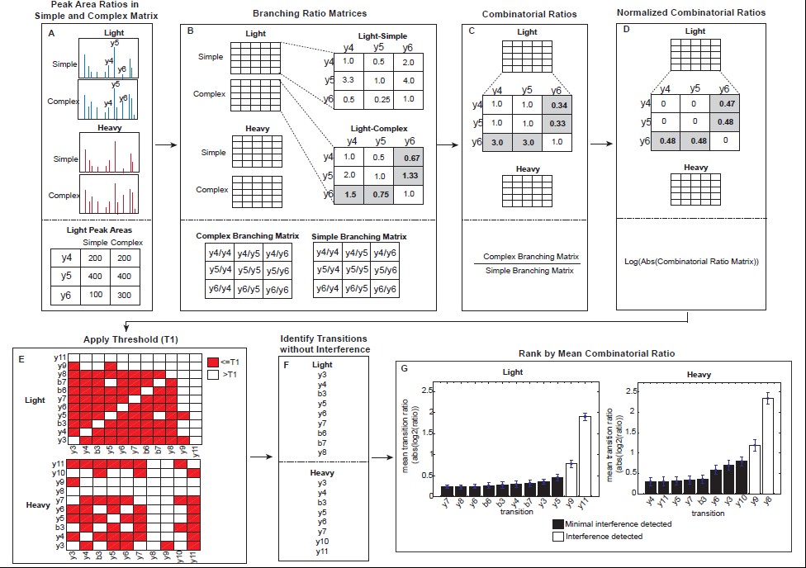

Slide 44
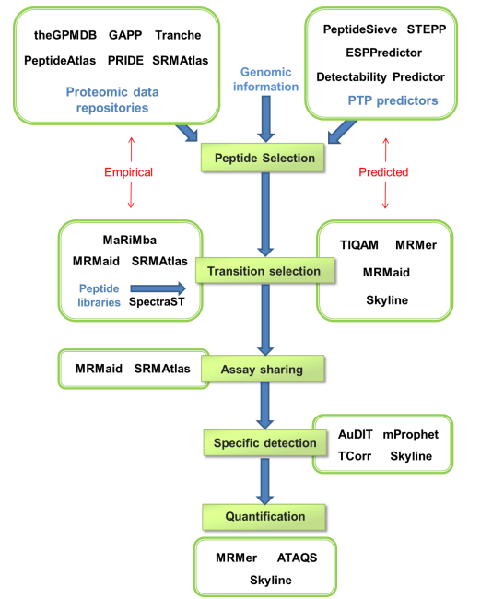
Open Source MRM analysis tools

Slide 45
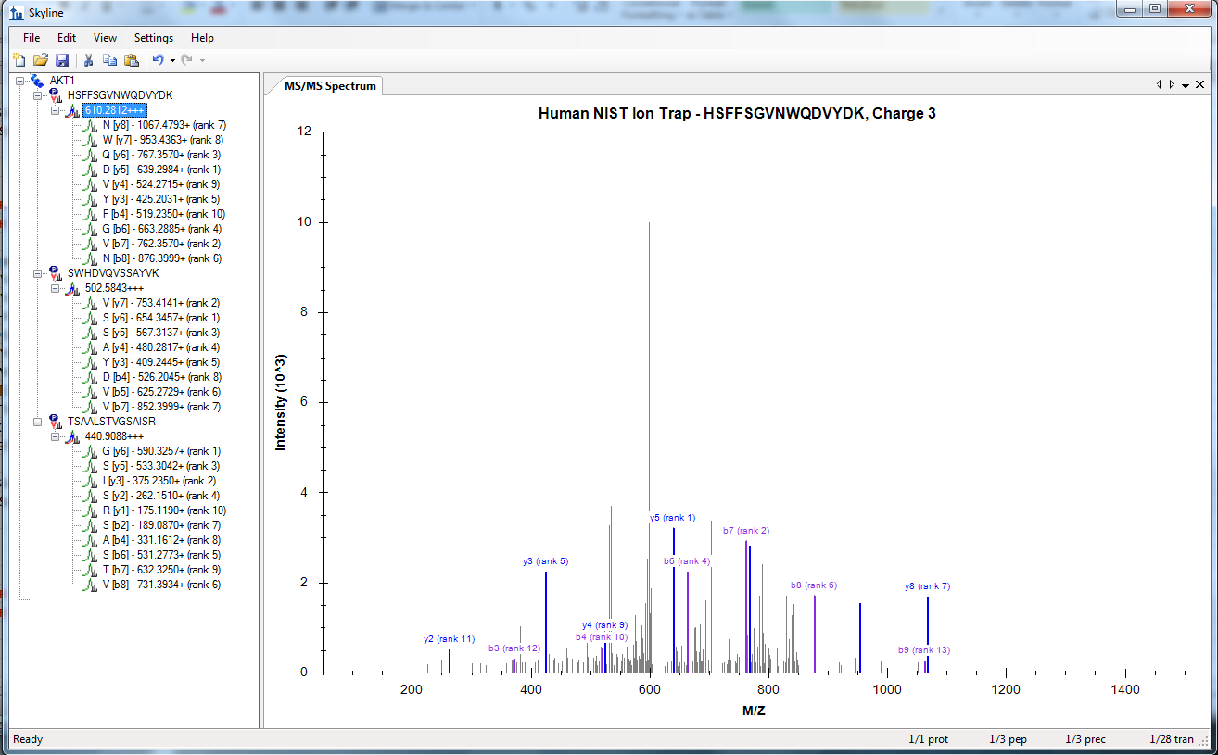
SKYLINE for creating targeted MS/MS methods
Skyline digests proteins and fragments peptides and uses spectral library to find transition intensity

Slide 46
Skyline for MRM: Method Building
Input all peptides of interest
Shows graphs of MS/MS spectra from spectral library

Slide 47
Skyline for MRM: Method Building
Helps generate protetypic peptide lists using MS/MS spectral libraries
Find which peptides can be measured in specific matrix
Find best transitions to measure for a peptide
Creates transition lists and vendor-specific instrument methods for MRM experiements

Slide 48
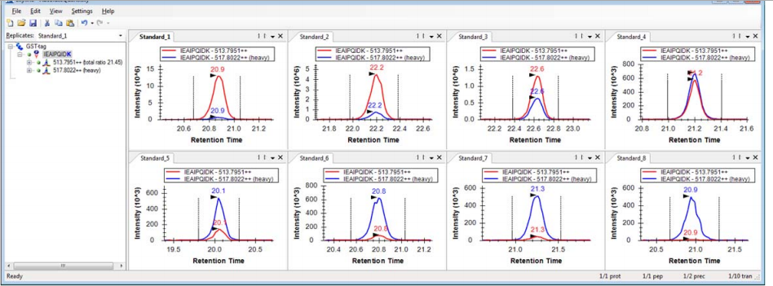
Skyline for MRM: Quantification
Import raw files into skyline
Pick peptide of interest
Check standard peaks

Slide 49
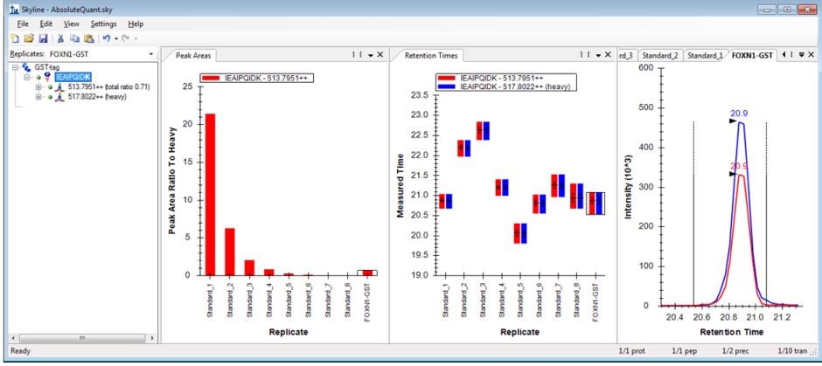
Skyline for MRM: Quantification
Use the heavy standard PAR to make calibration curve
Determine sample quantity based on curve

Slide 50
Questions?

Slide 51
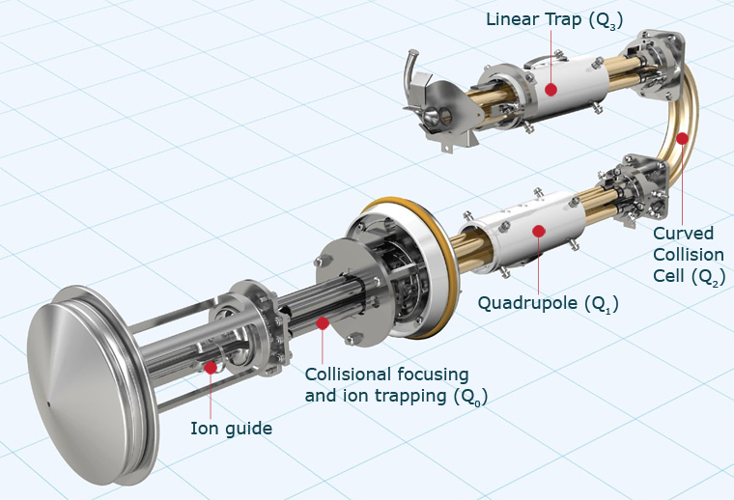
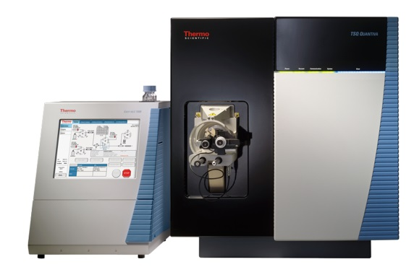
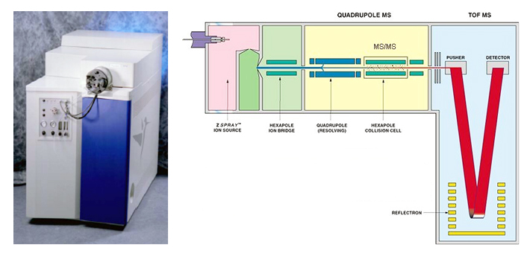
MRM Instrumentation
Triple Quadrupole
Quadrupole Time-of-Flight (Qqtof)

